Slide 1
Lecture Series Thirimachos Bourlai
Machine Learning – Pattern Recognition
Multiclass – Over/Under fitting; Cost Function
(c) Bourlai 2021 - Confidential and Proprietary Information – Reproduction and Disclosure Strictly Prohibited
Main Source: ML Stanford HERE

Slide 2

What we have covered so far:
Part 1: Intro in Supervised Learning
Part 2: Intro in Unsupervised Learning
Part 3: Linear Regression
Model Representation
Cost Function
Gradient Descent
Feature Scaling
Learning rate
Polynomial Regression (Non-Linear)
GD vs. Normal Equation

Slide 3
What we have covered so far:
Part 4: Logistic Regression
Classification
Decision Boundary
Cost Function
Optimization
Overfitting
Regularization in Linear Regression
Regularization in Logistic Regression
Other Optimization Algorithms (Conjugate GD; BFGS etc.)

Slide 4
PART 5: Rest of Lecture - Supported with Audio
What will be covered here is an overview
Multiclass Classification
Over-fitting
Under-fitting
Cost-Functions
How we need to update them to have Regularized Linear and Logistic Regression

Slide 5
Multiclass Classification
Example 1: Social Media Messages
Example 2: Weather Conditions
Example 3: Health Status Condition

Slide 6
Multiclass Classification
Binary Classification
Multi-Class Classification
X2
X2
CLASS 1
CLASS 1
CLASS 3
1 2 3 4
1 2 3 4
CLASS 2
CLASS 2
1 2 3 4
1 2 3 4
X1
X1

Slide 7
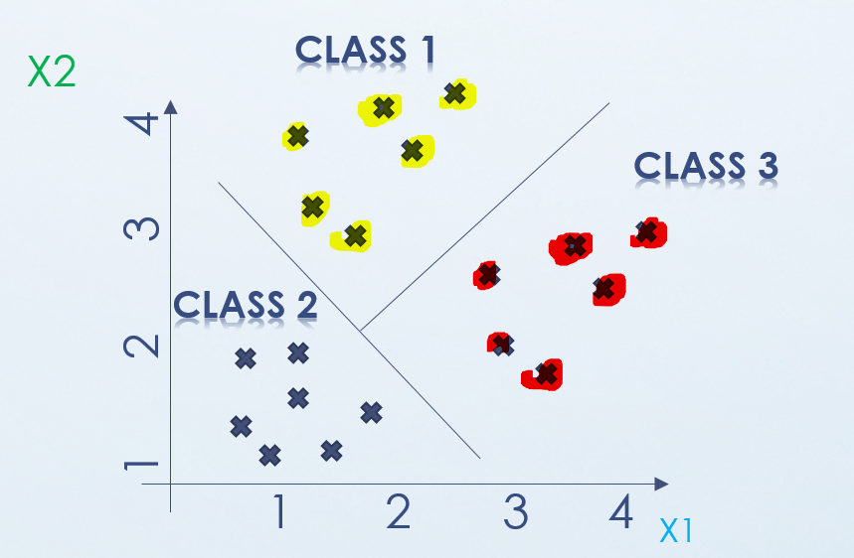
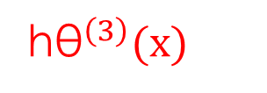
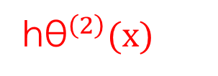
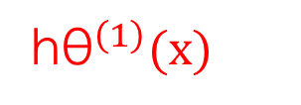
Multiclass Classification
h${\text{θ}}^{\left(2\right)}(x)$
X2
CLASS 1
1 2 3 4
CLASS 2
1 2 3 4
X1
X2
CLASS 2
CLASS 2
h${\text{θ}}^{\left(1\right)}(x)$
X2
h${\text{θ}}^{\left(3\right)}(x)$
1 2 3 4
1 2 3 4
CLASS 1
CLASS 1
1 2 3 4
1 2 3 4
X1
X1

Slide 8
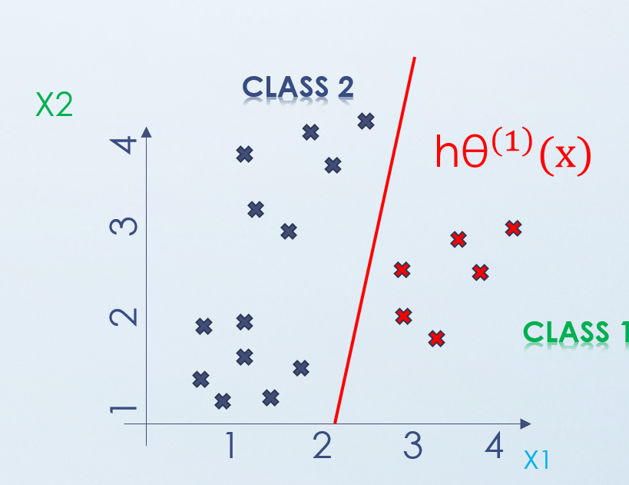
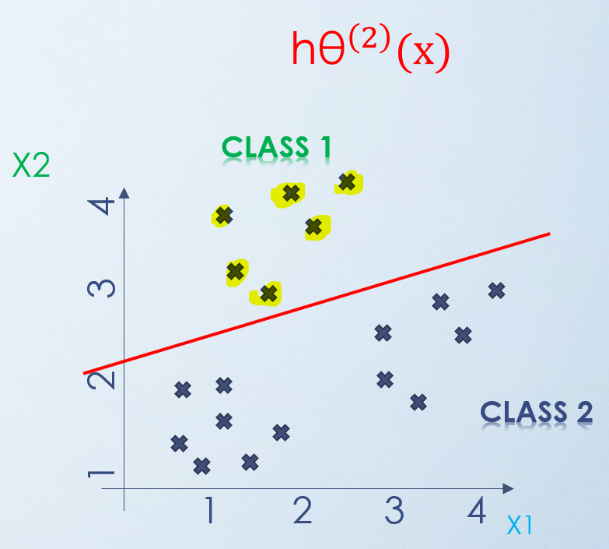
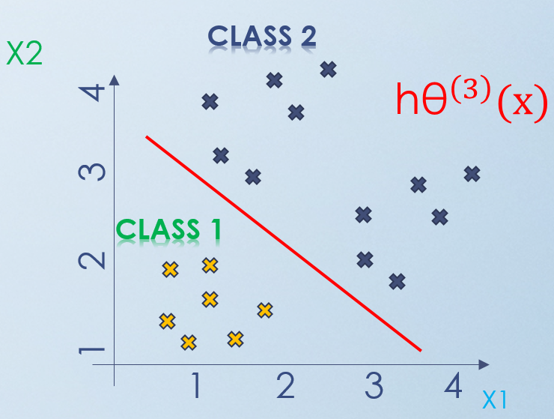
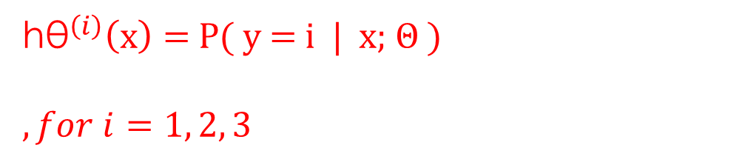
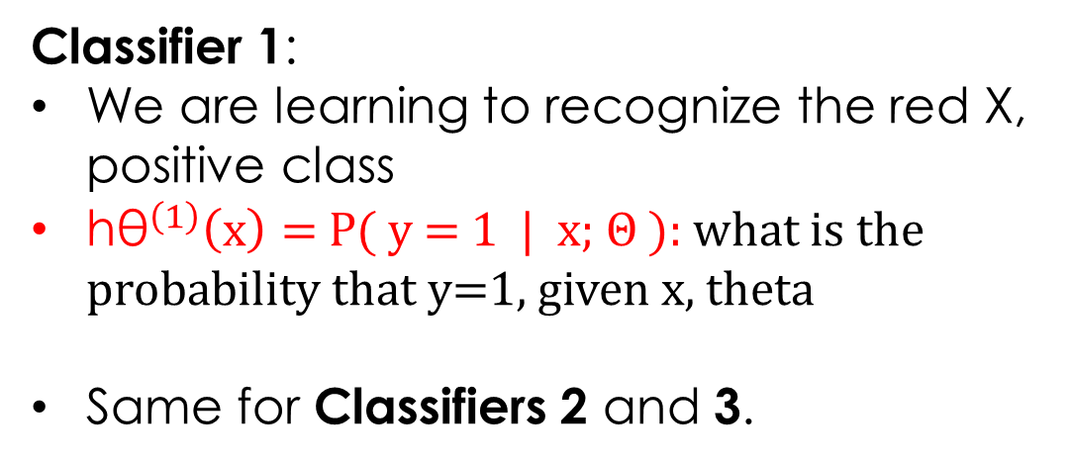
Multiclass Classification
One vs. All Problem
Classifier 1
h${\text{θ}}^{\left(i\right)}\left(x\right)=$P( y = i | x; Θ )
$, for i=1, 2, 3$
Classifier 2
Classifier 1:
We are learning to recognize the red X, positive class
h${\text{θ}}^{\left(1\right)}\left(x\right)=$P( y = 1 | x; Θ ): what is the probability that y=1, given x, theta
Same for Classifiers 2 and 3.
Classifier 3

Slide 9
Multiclass Classification
This is a type of a classification problem - when we have data that can be grouped into more than two categories, e.g. n categories (n>2).
Instead of y = {0, 1}, we will now have so that y = {0, 1..., n}
Since y = {0, 1..., n}, we divide our problem into n+1 (+1 because the index starts at 0) binary classification problems
For each classification problem → we need to compute the probability that the output y belongs to one of the n categories (classes)

Slide 10
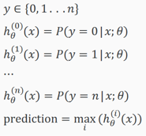
Multiclass Classification
PROCESS:
We choose the first class (main class)
Use all data and move them into a single second class
Applying binary logistic regression
Use the hypothesis that returned the highest value as our prediction
We repeat steps 1 – 4, where at step 1 we move on using the second class as our main class and so on… until we use all classes n.

Slide 11
Multiclass Classification - Summary
Thus:
For each class (i, i=0,…,n) → we train a logistic regression classifier h^{(i)}_{θ}(x) for each class i to predict the probability that y is equal to i
For a given input x, we compute all h^{(i)}_{θ} (x) for each i (i.e. all n classes)
Pick the class i that maximizes h^{(i)}_{θ}(x), namely the value of i (i.e. the class i) that give us the highest probability ….
Thus, we predict y to be that value (i.e. that class).

Slide 12
Over-fitting Under-fitting Regularization

Slide 13
Overfitting
Problem
Challenges
Solution

Slide 14
Under vs. Over vs. Just Right > Linear Regression
House Value ($1000)
House Value ($1000)
House Value ($1000)
House Size (square feet)
Living Area
House Size (square feet)
Living Area
House Size (square feet)
Living Area
h(x) = Θo + Θ1· x¹
+ Θ2· x²
+ Θ3· x³
+ Θ4· x⁴
h(x) = Θo + Θ1· x
h(x) = Θo + Θ1· x¹
+ Θ2· x²
Over-fit
or
High-Variance
Under-fit
or
High-Bias
Just Right

Slide 15
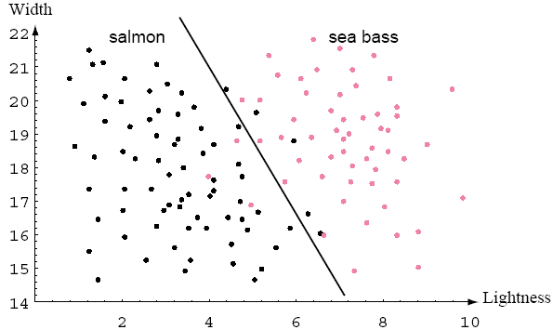
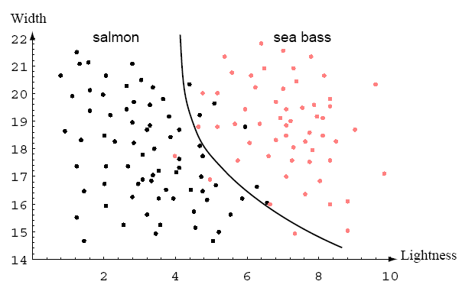
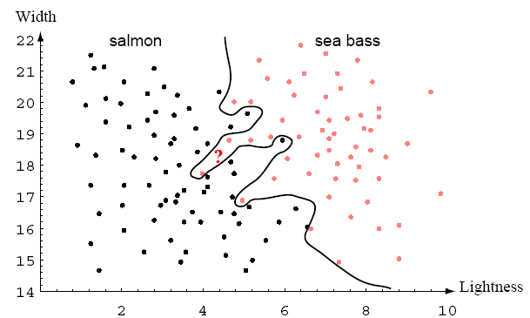
Under vs. Over vs. Just Right > Logistic Reg.
h(x) = g(Θo + Θ1· x¹
+ Θ2· x²
+ Θ3· x³
+ Θ4· x⁴)
h(x) = g(Θo + Θ1· x)
h(x) = g(Θo + Θ1· x¹
+ Θ2· x²)
G = sigmoid function
Over-fit
or
High-Variance
Under-fit
or
High-Bias
Just Right

Slide 16
Over-fitting and Under-fitting
(Applies to both linear and logistic regression)
Extreme 1: Under-fitting
Under-fitting, or high bias is the case where h_{θ}(x) does not map the trend of the data accurately
Usually this is due to the usage of a “very simple” function, or a function that does not use enough features

Slide 17
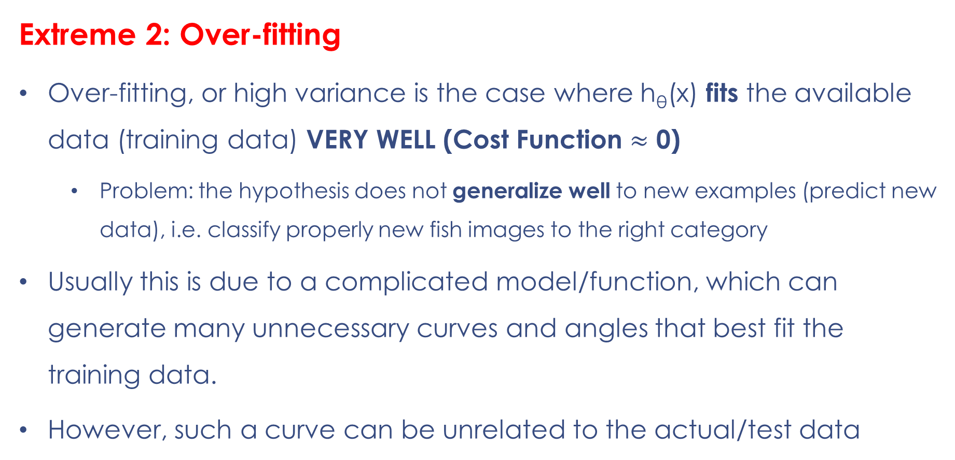
Over-fitting and Under-fitting
(Applies to both linear and logistic regression)
Extreme 2: Over-fitting
Over-fitting, or high variance is the case where h_{θ}(x) fits the available data (training data) VERY WELL (Cost Function $≈$ 0)
Problem: the hypothesis does not generalize well to new examples (predict new data), i.e. classify properly new fish images to the right category
Usually this is due to a complicated model/function, which can generate many unnecessary curves and angles that best fit the training data.
However, such a curve can be unrelated to the actual/test data

Slide 18
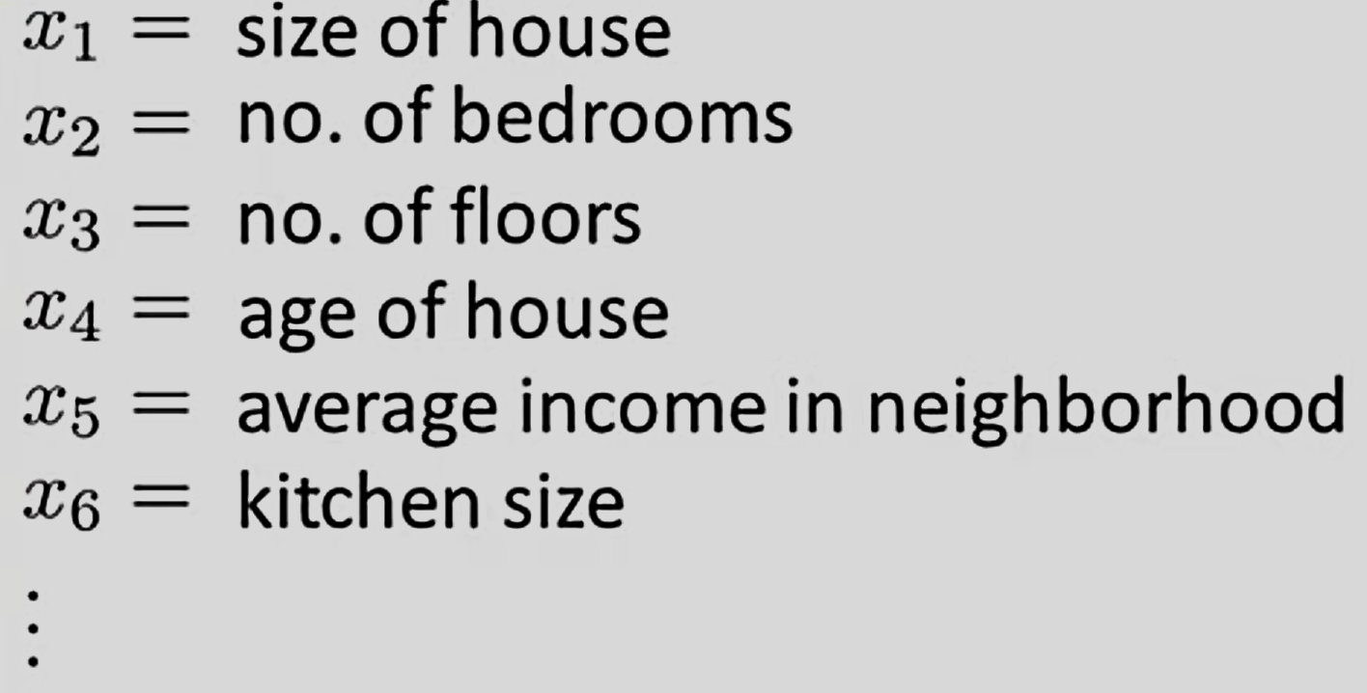
House Value ($1000)
Over-fitting
How can we address this issue?
OPTION (1) Lower down the number of features
Select the features we need to keep (MANUALLY)
Employing a model selection algorithm that reduces complexity
House Size (square feet)
Living Area

Slide 19
Over-fitting
How can we address this issue?
OPTION (2) Regularization
Features are NOT reduced
However, the magnitude of the parameters θj is reduced
Regularization is a good solution and works well:
When we have a lot of features that all contribute enough to better predict/classify y

Slide 20
Regularization
Problem
Challenges
Solution

Slide 21
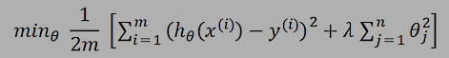
Challenge
House Value ($1000)
House Value ($1000)
We have the optimization problem to solve as per the equation below
House Size (square feet)
Living Area
House Size (square feet)
Living Area
h(x) = Θo + Θ1· x¹
+ Θ2· x²
h(x) = Θo + Θ1· x¹
+ Θ2· x²
+ Θ3· x³
+ Θ4· x⁴
Just Right
Over-fit
or
High-Variance

Slide 22
Why regularize?
We are aiming to lower the impact of theta parameters (Theta 0,1, 2, …, n)
Outcome
Essentially thetas will become very small (almost eliminated) and thus our H(THETA) will become simpler
Our model will be able to better generalize (not over-fit)
Term 1
Term 2

Slide 23
What we achieve – simple example
House Value ($1000)
House Value ($1000)
House Size (square feet)
Living Area
House Size (square feet)
Living Area

Slide 24
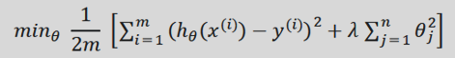
SUMMARY – REGULARIZATION (1)
How can we work with this function to avoid overfitting?
We can eliminate the influence of specific/selected theta (θ) parameters of the hypothesis
We can regularize all our theta (θ) parameters in a single summation as:

Slide 25
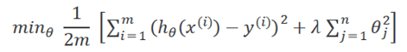
SUMMARY – REGULARIZATION (2)
How can we work with this function to avoid overfitting?
Lambda (λ), is the regularization parameter → it controls the effect of our θ parameters to the cost function
The extra summation (with λ) smooths the output of our hypothesis function and thus, reduces overfitting

Slide 26
Regularization – How do we pick LAMPDA?
How can we work with this function to avoid overfitting?
A too big λ → can smooth out the function too much and, thus, cause under-fitting
A too small λ → removes completely the regularization effect and thus, we cannot better control overfitting

Slide 27
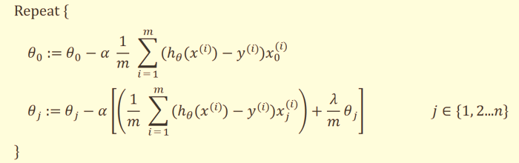
Regularization --- How do we apply it?
In linear regression, we still use the gradient descent.
We need to modify the GD function: separate θ0 (we do not want to penalize it) and add the term with lamda (λ)

Slide 28
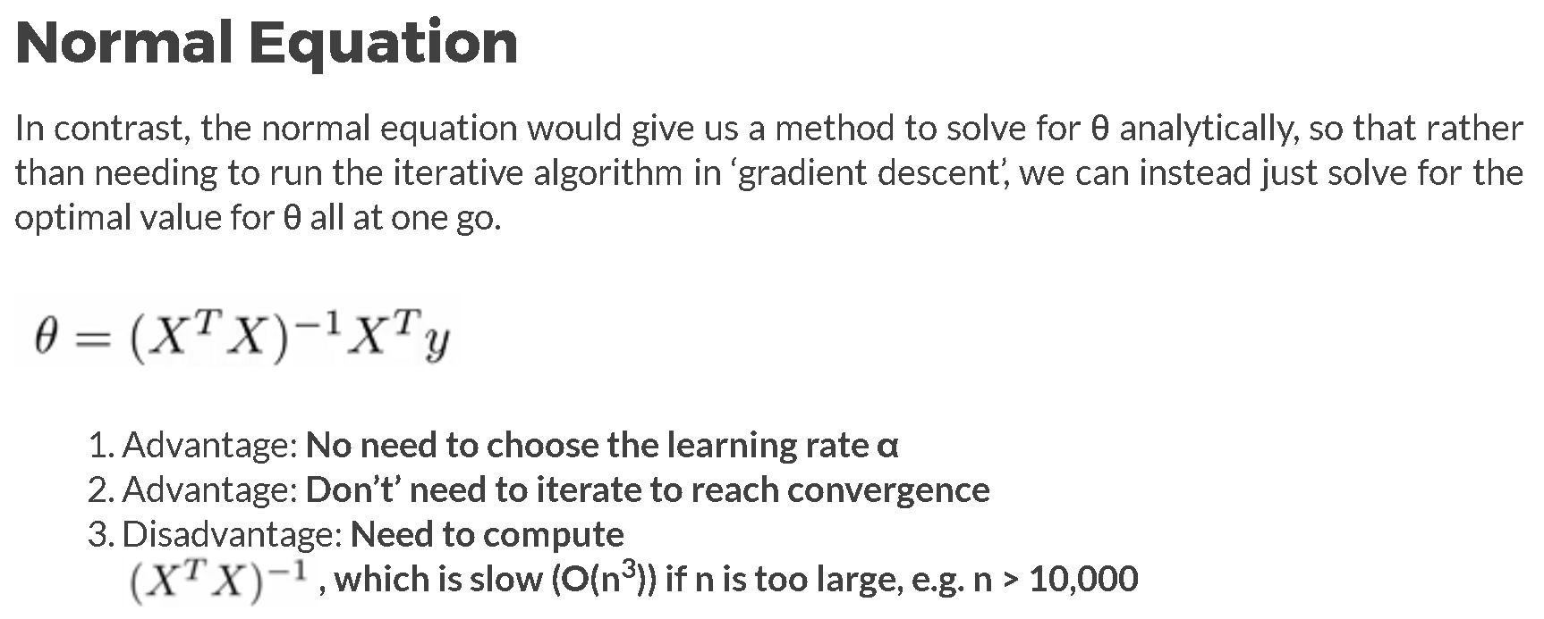
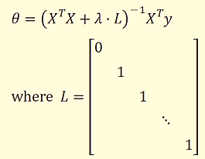
Regularization --- Using the Normal Equation
In terms of the Normal equation, we have a minor modification too (see right equation below) with capital lambda

Slide 29
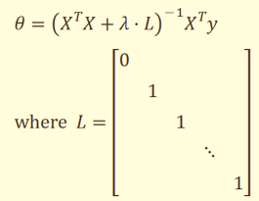
Regularization --- Using the Normal Equation
How about when a matrix in NON-INVERTIBLE?
Challenge:
#Training Examples (m) < # Features (n)
Original X^{T}X > singular / non-invertible
Depending on the package you are using this can be solved or not
Benefit of Regularization:
In this case, if we have λ>0, the matric will NOT be singular

Slide 30
Regularization --- How do we apply it?
In logistic regression
We still use the gradient descent
We can use advanced optimization algorithms
Provide an alternative way to:
Compute the cost function → J(Θ)
Compute the cost functions’, i.e. the J(Θ)’s derivatives

Slide 31
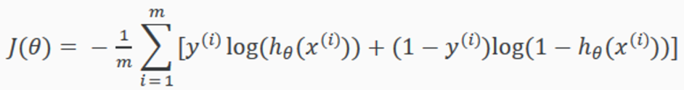
Regularization --- How do we apply it?
h(x) = g(Θo + Θ1· x₁ + Θ2· x₁² + Θ3· x₁ x₂³ +
Θ4· x₁²x₂² +Θ5· x₁²x₂ ⁺ ………… )
X1
CLASS 2
CLASS 1
The ORIGINAL cost function for the Logistic Regression can be written as follows:
1 2 3 4
1 2 3 4
X2
Overfitting> need regularization

Slide 32
Regularized Logistic Regression
Original Logistic Regression
Logistic Regression with Regularization
X1
CLASS 2
CLASS 1
1 2 3 4
1 2 3 4
X2

Slide 33
Regularized Logistic Regression using Gradient Descent
Logistic Regression with Regularization
The second sum → we exclude θ0 (bias), and j=1 to n
Thus, GD is the same as with the linear regression, where we leave θ0 out.
Key Equations:
h_{θ}(x) = g(θ^{T}·x)
z = θ^{T}·x
g(z) = 1/[1+exp(-z)]

Slide 34
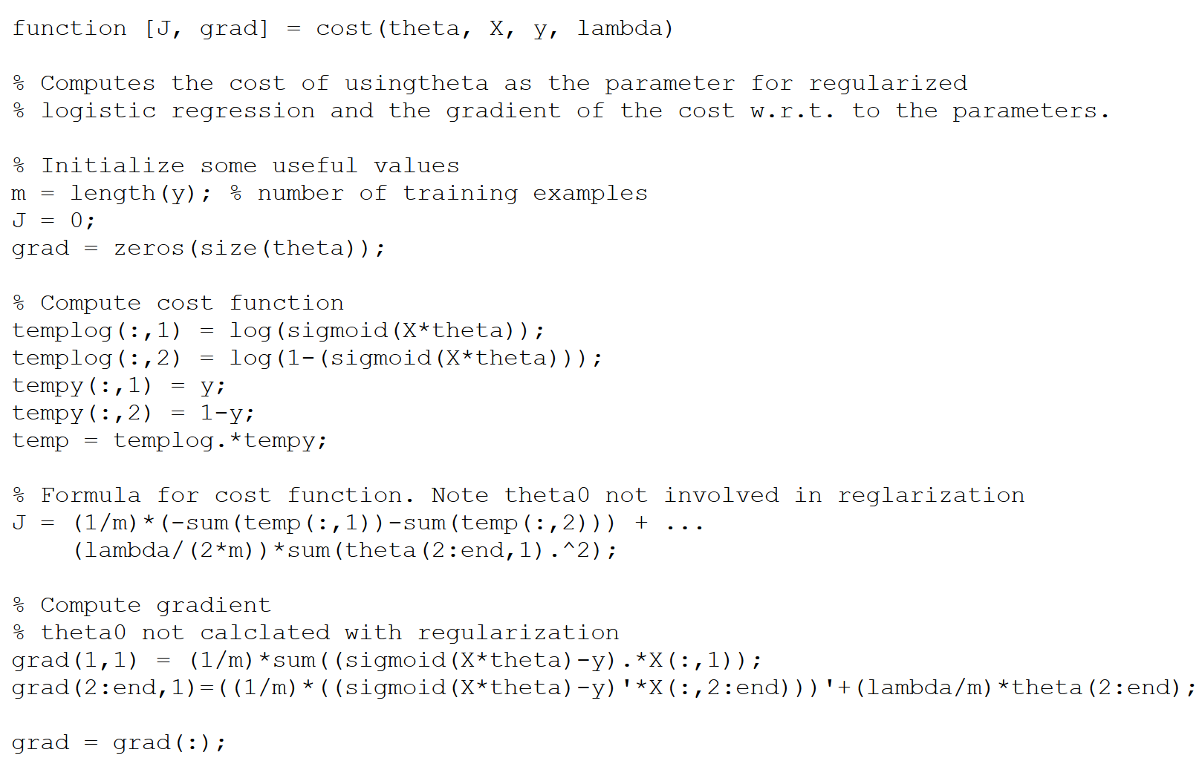
Reg. Logistic Regression > Matlab
HERE

Slide 35
Summary
What have we covered today --- an overview of…
Multiclass Classification
Over-fitting
Under-fitting
Cost-Functions
How we need to update them to have Regularized Linear and Logistic Regression

